Slide 1
PHD Progression 10
Explainable AI with Visual analytics

Slide 2
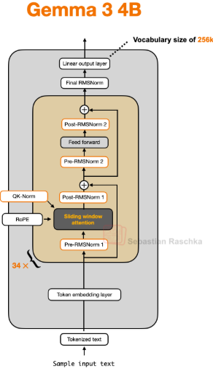
LLM architecture
We have previously looked at masked multi-head attention, we’ll now be looking at other components of the transformer
Tokenize
Token embedding
Positional embedding
Input embedding
Masked Multi-head attention

Slide 3
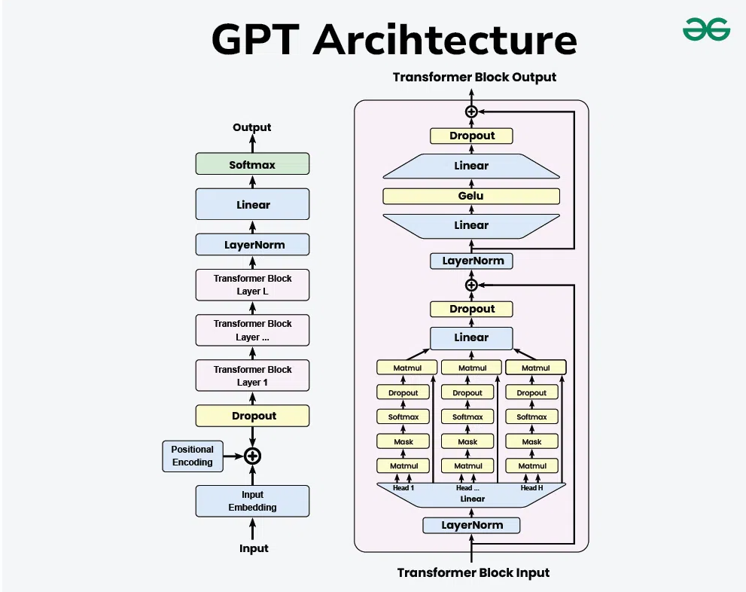
Transformer Block in GPT
Layer Normalization
Masked-Multihead attention
Gelu Activation function
Feed forward network
Short connections

Slide 4
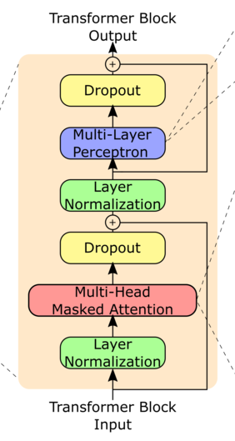
Layer Normalization
Training deep neural networks, can be challenging due to vanishing and exploding gradients.
Due to this unstable training dynamic, we need layer normalization
Layer Normalization is usually applied before and after the multi-head attention

Slide 5
Layer Normalization
Layer normalization makes sure the mean and standard deviation of the output from every layer is fixed, thereby accelerating convergence and allowing us to get output faster
Mean = 0, variance = 1 after layer normalization

Slide 6
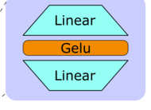
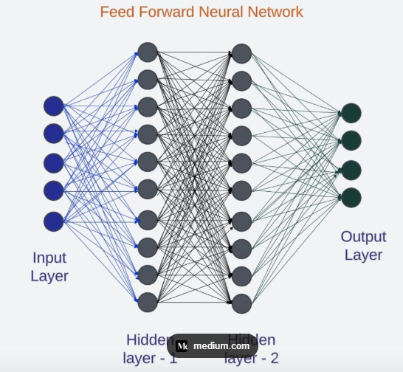
feed forward (GELU Activation function )
The feed forward network has an activation function in between two linear neural networks
This two neural networks allows for a rich exploration space, through expansion and contraction
768 => 768 x 4 => 768

Slide 7
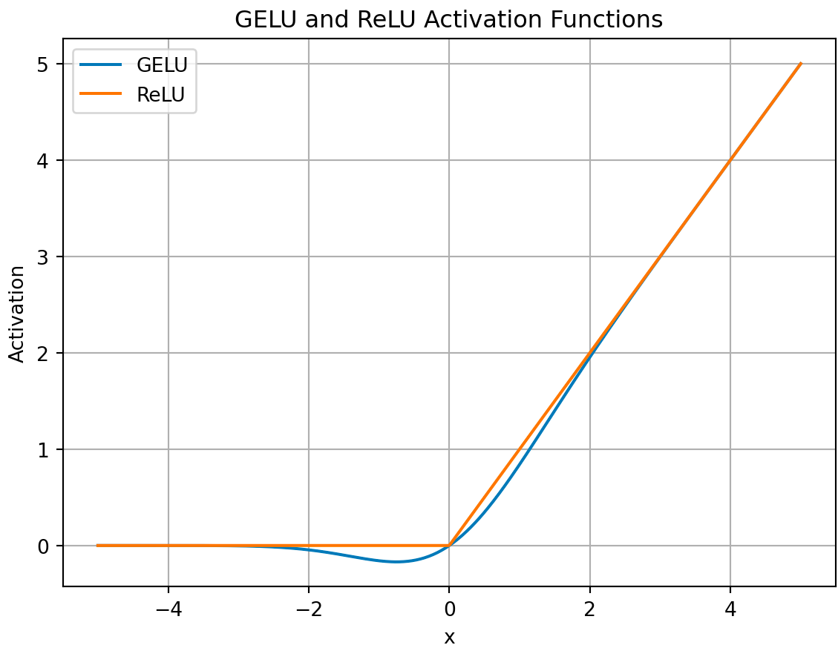
feed forward (GELU Activation function )
The activation function used in this LLM is the GELU activation function
GELU(x) = xΦ(x)
GELU(x) = 0.5x(1 + tanh(√(2/π)(x + 0.044715x³)))

Slide 8
Advantages of GELU over RELU for LLMs
There is no discontinuity in GELU, it is smooth through x
Prevents dead neuron problem
Works better than RELU for LLMS

Slide 9
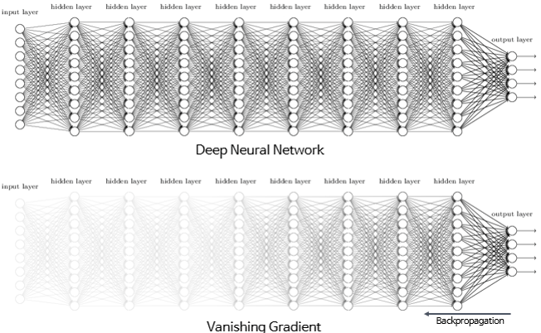
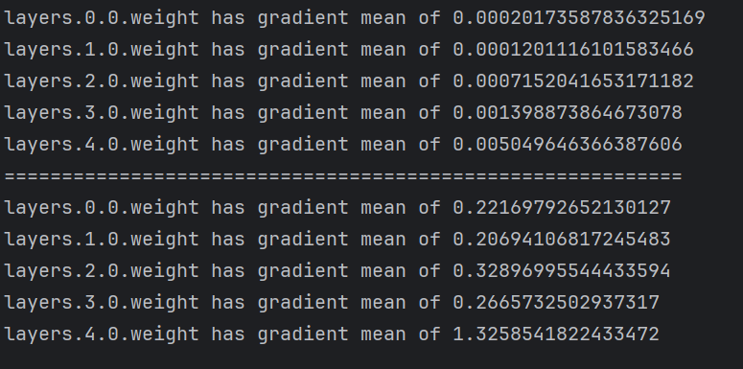
Shortcut connections
Also known as skip or residual connections
They were first proposed in the field of computer vision to solve the vanishing gradient problem
Shortcut connections create an alternative path for the gradient to flow, by skipping one or more layers

Slide 10
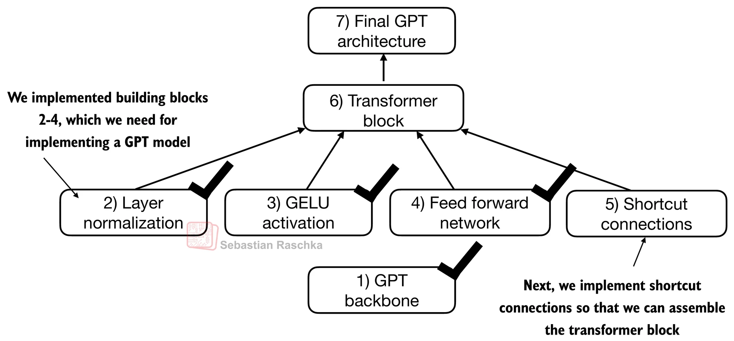
LLM architecture
Tokenize
Token embedding
Positional embedding
Input embedding
Masked Multihead attention
Dropout
Layer normalization
Feed forward network
GELU activation function
Shortcut connections
Linear output head

Slide 11
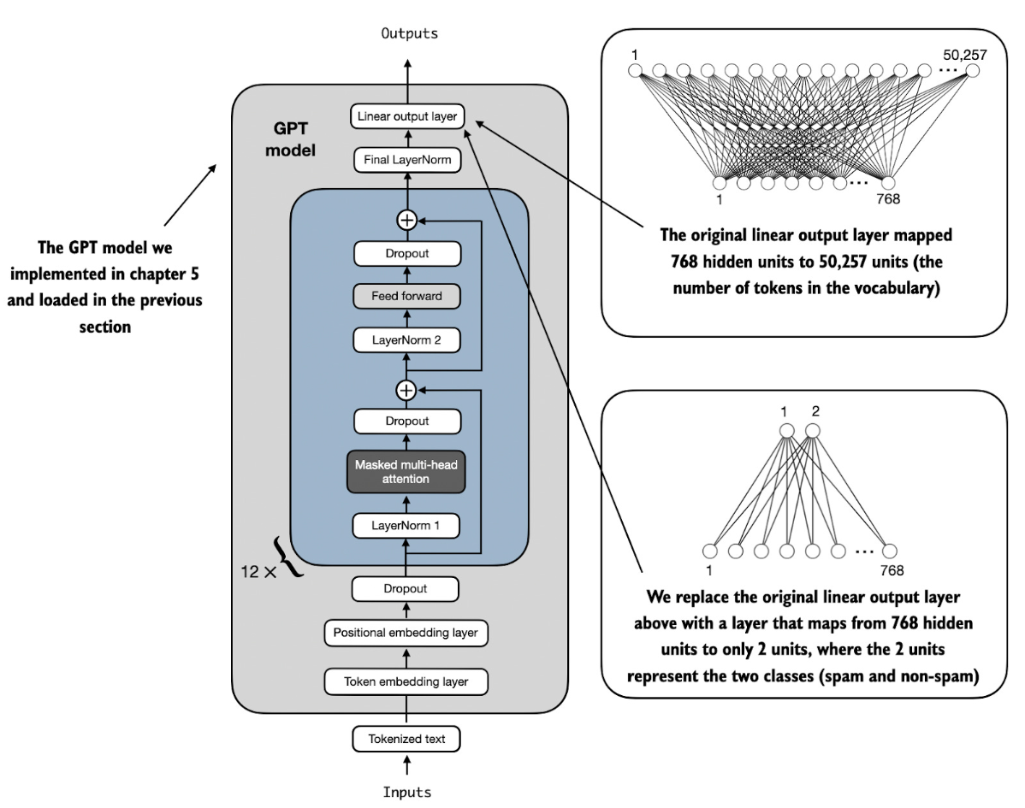
Linear output head
This changes the dimension of the embedding from 768 to the vocabulary size 50257
The 50527 tokens of GPT are outputs received as logits
We normalize this logit to get the probability

Slide 12
Linear output head
Each token is now assigned a probability that it will be the next word
GPT selects the highest probability and that will be the next token
This is repeated until we reach our limit of sequence

Slide 13


A Multiscale Visualization of Attention in Transformers -Jesse Vig

Slide 14
Introduction
Progress in NLP tasks since introducing the attention mechanism with the use of transformers
Recurrent networks were previously used, and lacked the ability to understand context, especially in longer sequences.
The major challenge visualizing attention now are multiple attention heads producing different patterns in multiple layers.

Slide 15
BERTVIZ Views
The three views used in this tool for GPT and BERT are
attention-head view,
model view,
neuron view

Slide 16

Attention head view
Visualizes the attention patterns produced by one or more attention heads in each layer
attention is represented as lines connecting the tokens that are attending with the tokens being attended to
Users can also filter attention by token, as shown in figure 1
Sentence-pair model is used for BERT; users can specify a sentence-level attention filter.

Slide 17
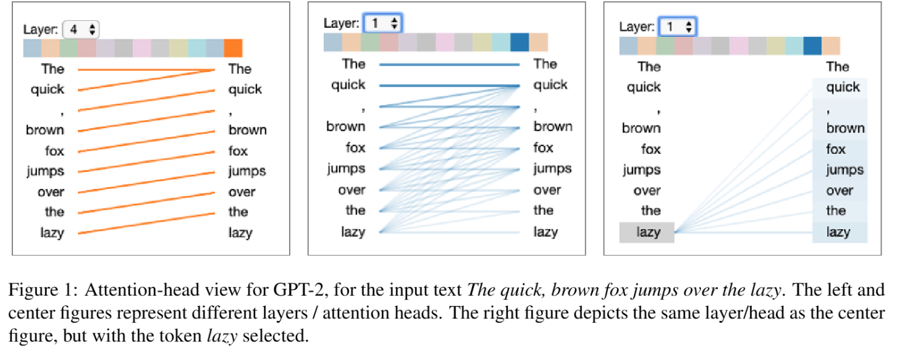
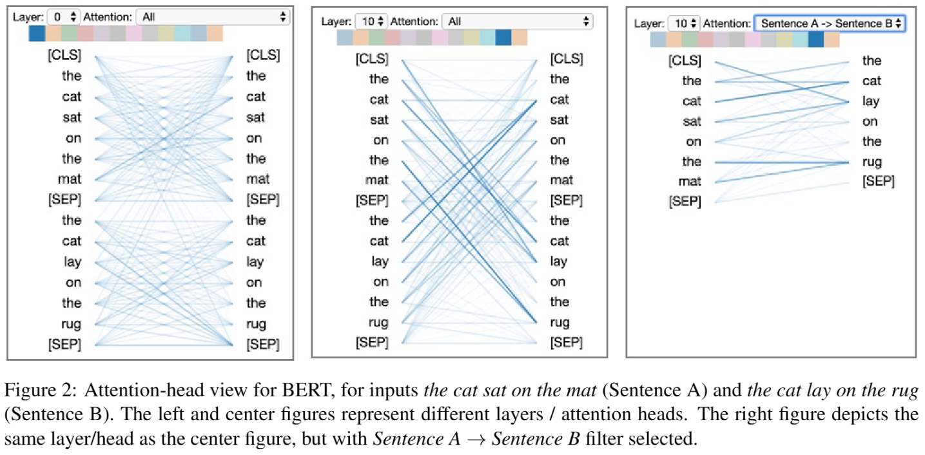
Attention head view

Slide 18
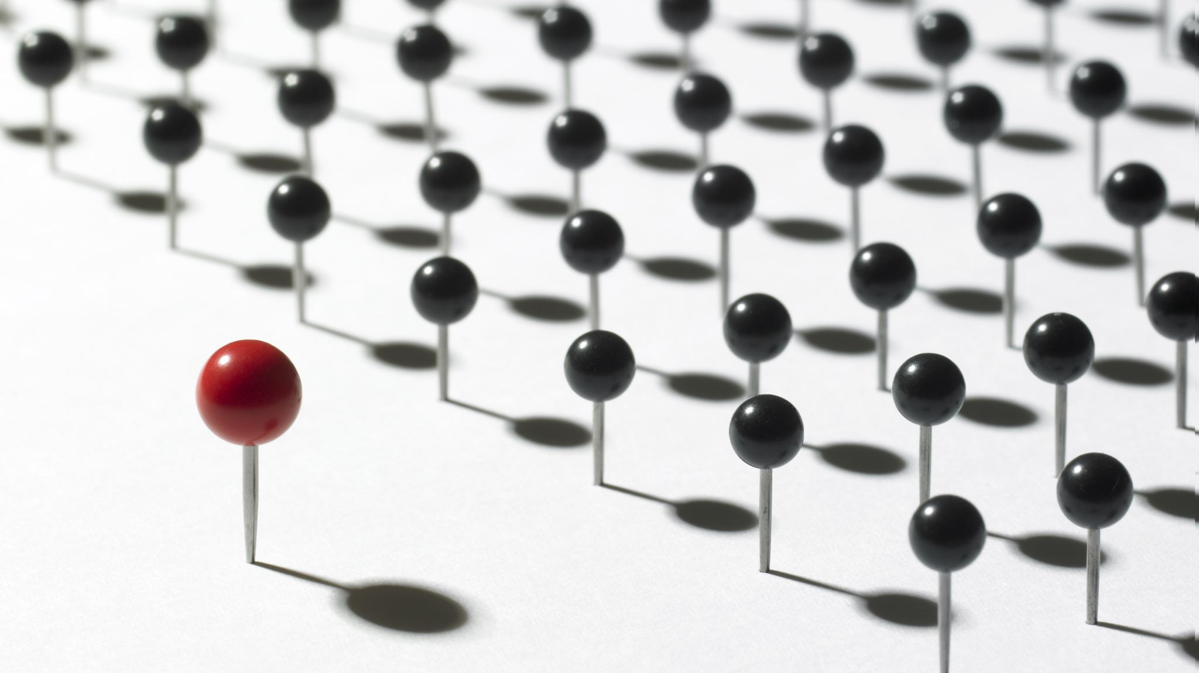
Attention head view
Besides positional patterns, attention heads also capture specific lexical patterns
in figure 3. Other attention heads detected
named entities,
paired punctuation,
subject-verb pairs
other syntactic and semantic relations.

Slide 19
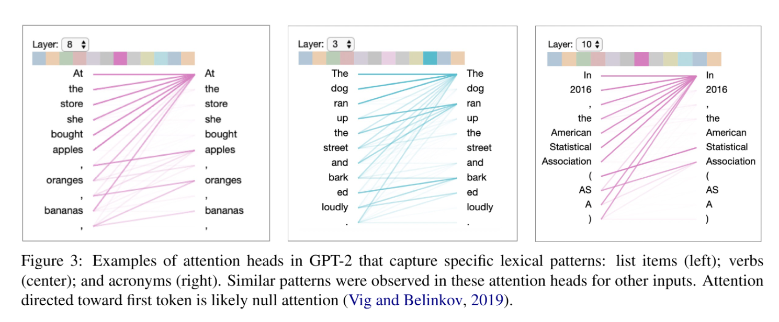
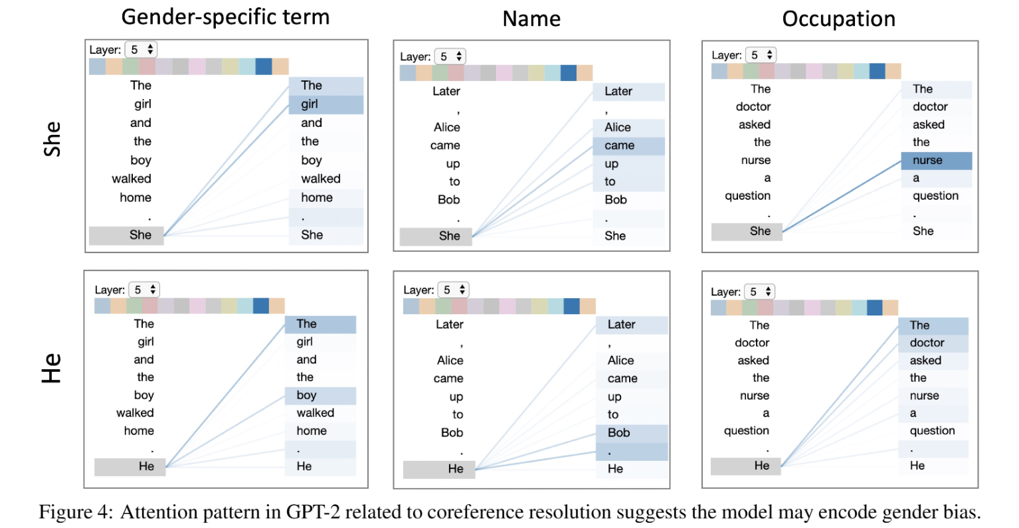
Attention head view

Slide 20

Use case for attention-head view
The doctor asked the nurse a question.
“The doctor asked the nurse a question. She said, “I’m not sure what you’re talking about.”
“The doctor asked the nurse a question. He asked her if she ever had a heart attack”.
the detection of bias in the model
GPT-2 was asked to generate new words
This shows the models coreference mechanism may encode gender bias,
The two examples are shown in figure 4 (right), which reveals she attended strongly to nurse, while he attends more to doctor.

Slide 21
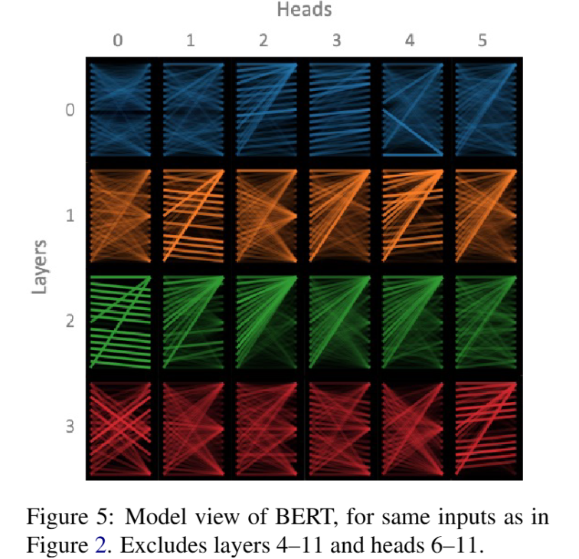
Model view
The model view provides birds eye view of attention across all the model’s layers and heads for a particular input
Users can also click on any head to enlarge tokens, and access attention head view.

Slide 22
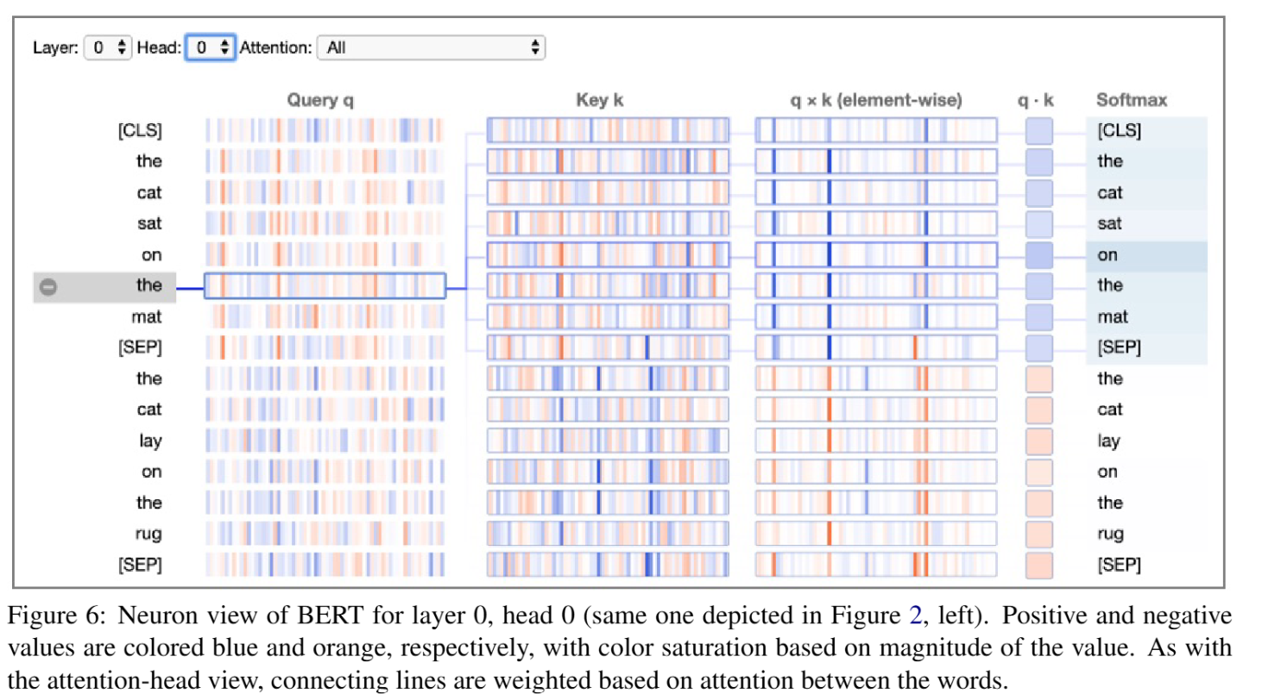
Neuron view
visualizes the individual neurons in the query and key vectors and shows how they interact to produce attention
The attention decays with increasing distance from the source token.

Slide 23
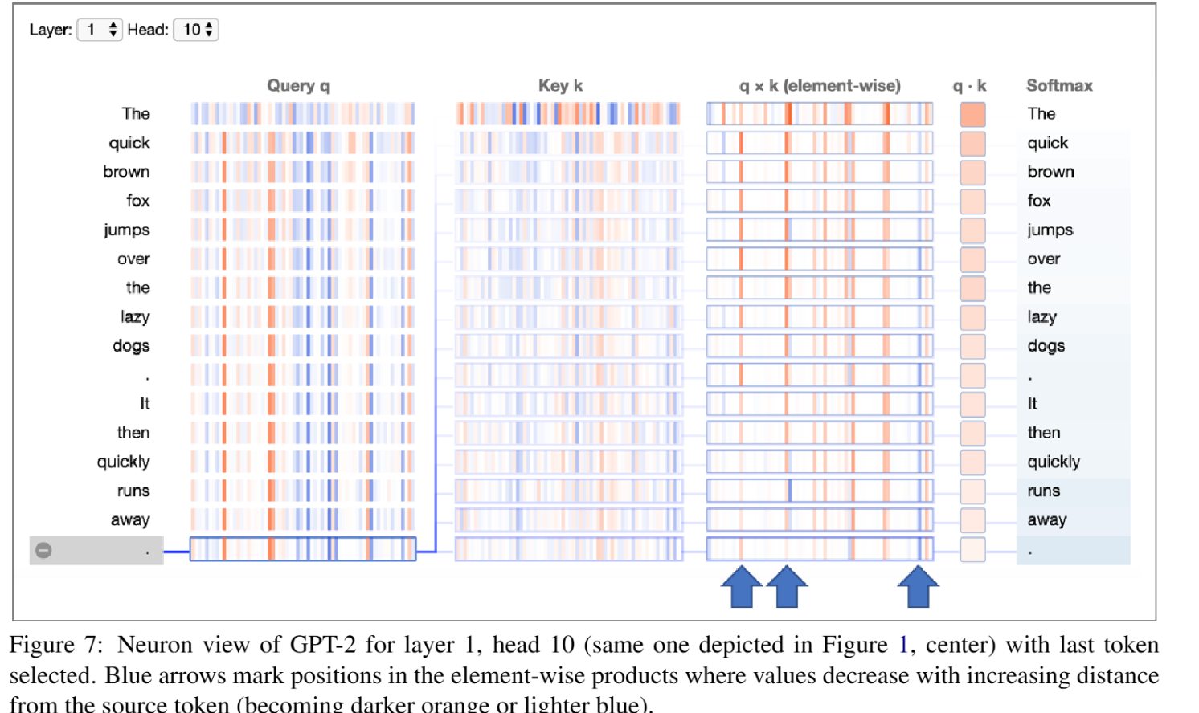
Neuron view
a small number of neuron positions appear to be mostly responsible for the distance decaying attention pattern
at this neuron positions, the element-wise product q x k decreases as the distance from source token decreases (either becoming darker orange or lighter blue)

Slide 24
Supervisors feedback
Optimize the code to be more understandable
What kind of visualization is required in the industry e.g. health field, finance field etc.
Focus on integrating front end for visualization of components
Start working towards an early-stage prototype
Look at the very recent papers to understand the recent landscape XAI with visual analytics for transformer
Get a list of the required training and learning needed to complete this project
Start working towards publishing a literature review

